Slide 1




TECHLATORS
IDENTIFYING AND PRIORITIZING
VULNERABILITIES

Slide 2


COMMON TYPES OF VULNERABILITIES IN WEB APPLICATIONS
1. SQL Injection (SQLi)
· Vulnerability: Injecting malicious SQL code to manipulate database queries.
· Impact: Unauthorized data access, modification, or deletion.
· Prevention: Use parameterized queries, input validation, and limit database privileges.
2. Cross-Site Scripting (XSS)
· Vulnerability: Injecting malicious JavaScript code to steal user data or take control.
· Impact: Session hijacking, sensitive data theft, or malware distribution.
· Prevention: Validate user input, encode output, and implement Content Security Policy (CSP).

Slide 3
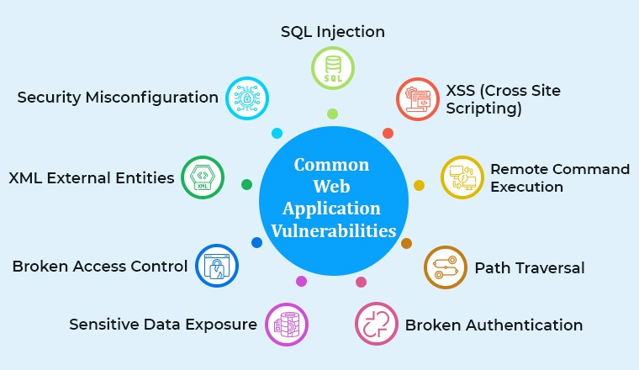
COMMON TYPES OF VULNERABILITIES IN WEB APPLICATIONS
3. Cross-Site Request Forgery (CSRF)
· Vulnerability: Trick users into performing unintended actions.
· Impact: Unauthorized transactions, data modification, or account takeover.
· Prevention: Implement token-based validation, header-based validation, or Same-Origin Policy.
4. Authentication and Authorization Weaknesses
· Vulnerability: Poor password storage, weak login mechanisms, or inadequate access control.
· Impact: Unauthorized access, data breaches, or privilege escalation.
· Prevention: Implement secure password storage (e.g., bcrypt), multi-factor authentication, and role-based access control.

Slide 4

5. Input Validation and Sanitization Weaknesses
· Vulnerability: Failing to validate and sanitize user input.
· Impact: XSS, SQLi, or command injection attacks.
· Prevention: Validate and sanitize user input using whitelisting, encoding, or escaping.

Slide 5
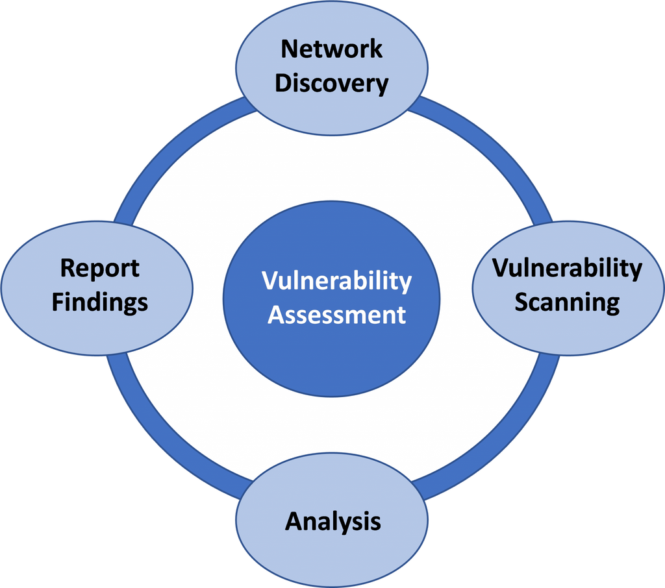
Assessing Vulnerability Severity
1. Impact
Definition: This factor addresses the potential damage or consequences that could occur if the vulnerability is successfully exploited.
Details: Impacts can include loss of sensitive data, financial loss, reputational damage, operational disruption, and legal consequences—the more severe the impact, the higher the vulnerability's severity rating.
2. Exploitability
Definition: This assesses how easily an attacker can exploit the vulnerability.
Details: Factors influencing exploitability include the complexity of the attack, the required skill level of the attacker, and the availability of automated tools or scripts that can exploit the weakness. A vulnerability that is easy to exploit will typically be rated higher in severity.

Slide 6

Assessing Vulnerability Severity
3. Likelihood of Exploitation
Definition: This refers to the probability that the vulnerability will actually be exploited in the real world.
Details: This factor considers current threat intelligence, the existence of active exploits, and historical data on similar vulnerabilities. A high likelihood indicates that organizations should prioritize addressing the vulnerability.
4. Attack Vector
Definition: The methods through which an attacker might exploit the vulnerability, such as network access, physical access, or through user actions (social engineering, for example).
Details: Vulnerabilities that can be exploited remotely over the internet generally have a higher severity ranking compared to those that require local access or physical presence.

Slide 7

Assessing Vulnerability Severity
5. Privileges Required
Definition: This factor looks at the level of access necessary for an attacker to exploit the vulnerability.
Details: Vulnerabilities that can be exploited without special privileges are typically rated higher than those that require administrative access, as they pose a greater risk to the general user environment.
6. User Interaction
Definition: This determines whether user interaction is required to exploit the vulnerability.
Details: Vulnerabilities that require no user involvement for exploitation are generally considered more severe, as they can be utilized without user awareness or intervention, increasing the risk.
7. Confidentiality, Integrity, and Availability (CIA) Impacts
Definition: This framework examines how a vulnerability affects the confidentiality (access to sensitive data), integrity (accuracy and reliability of data), and availability (system uptime) of systems and data.
Details: A significant breach in any of these areas can have serious consequences for an organization, thus elevating the severity ranking. For instance, a vulnerability that compromises sensitive data would have a high confidentiality impact and thus escalate its severity.

Slide 8
Assessing Vulnerability Severity
Importance of Severity Ranking
Prioritization: To address vulnerabilities that present the highest risk first, effective vulnerability management necessitates prioritizing. A severity ranking facilitates effective resource allocation for companies.
Risk management: Security teams can decide on risk acceptance, mitigation, and response tactics with knowledge of the seriousness of vulnerabilities.
Compliance and Regulations: Organizations must proactively manage vulnerabilities to comply with regulatory norms that govern many industries. Maintaining these standards improves the organization's reputation while reducing legal threats.
Incident Response: By facilitating the escalation procedures for incident response teams, a severity ranking enables quicker and more effective responses to serious vulnerabilities.
Stakeholder Communication: Clear communication regarding the severity of vulnerabilities enables better dialogues with stakeholders, ensuring that management and the board are informed about potential risks and necessary investments in cybersecurity.

Slide 9

Using Vulnerability Databases
CVE Vulnerability Research
Database Search
- Search by keyword, CVE ID, or product name
- Filter by vendor, product, version, severity, and exploitation status
CVE Details
- Review vulnerability descriptions and affected products/versions
- Access references (vendor advisories, security bulletins, exploit code) - Understand severity (CVSS scores)
Research Tools
- NVD (advanced search, vulnerability metrics)
- CVE Details (comprehensive vulnerability info)
- Exploit-DB (exploit code, proofs-of-concept)
- OpenVAS (vulnerability scanning, management)

Slide 10

Using Vulnerability Databases
CVE Vulnerability Research
Analysis & Reporting
- Map CVEs to products, versions, and configurations
- Assess vulnerability severity, exploitability, and impact
- Generate reports on vulnerabilities and remediation recommendations
By leveraging CVE and associated tools, researchers can efficiently identify, analyze, and report vulnerabilities, enhancing cybersecurity.

Slide 11

Likehood/Impact
Low
Medium
High
High
Medium risk (3)
High risk (4)
Highest risk (5)
Medium
Low risk (2)
Medium risk (3)
High risk (4)
Low
Lowest risk (1)
Lower risk (2)
Medium risk (3)
Creating a Risk Matrix
Likelihood
The possibility that a certain threat would take advantage of a particular vulnerability is known as likelihood in the context of risk assessment. In addition to impact, likelihood is a crucial component that needs to be taken into account to properly determine the degree of risk.
Impact
The harm that could be done to an organization and its assets if a certain threat took advantage of a particular vulnerability is referred to as impact in the context of risk assessment. To properly determine the degree of risk, the impact must be taken into account in addition to the possibility.

Slide 12

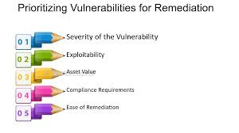
Setting Prioritization Criteria
Business Impact: Assess how a vulnerability could affect critical business functions. For example, a vulnerability in an e-commerce platform could directly impact revenue.
Exploitability: Consider how easy it is for attackers to exploit the vulnerability. A well-known and easily exploitable vulnerability, such as an unpatched SQL injection flaw, should be prioritized higher.
Regulatory Compliance: Identify vulnerabilities that could lead to non-compliance with regulations (e.g., GDPR, HIPAA). These should be prioritized to avoid legal penalties.
Threat Intelligence: Use threat intelligence to identify vulnerabilities actively being exploited in the wild. This helps prioritize vulnerabilities that pose immediate threats.
Asset Value: Focus on vulnerabilities in high-value assets first. For example, vulnerabilities in systems containing sensitive customer data should be addressed before those affecting less critical systems.
Organisations can improve their overall security posture by identifying, evaluating, and prioritizing vulnerabilities for remedy according to these principles.

Slide 13
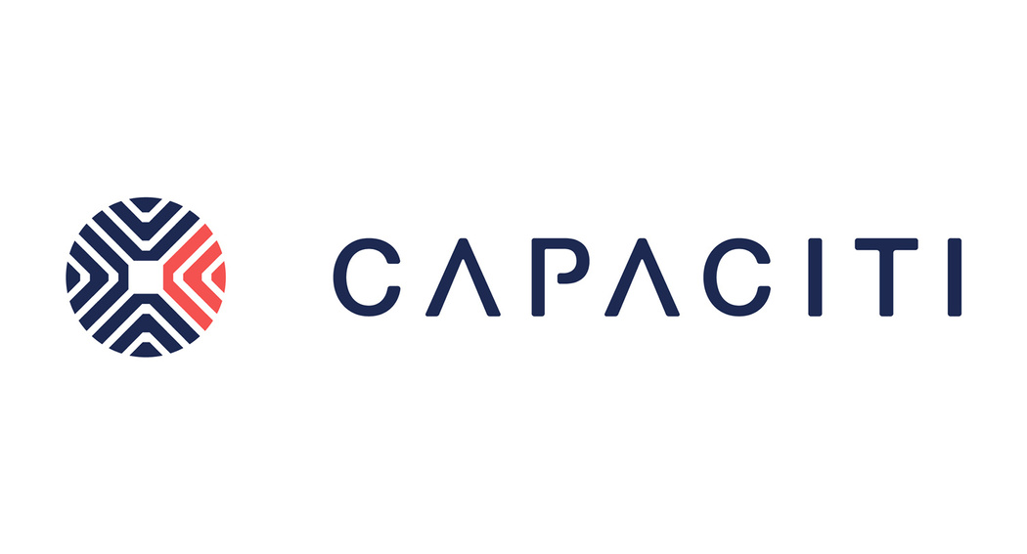



TECHLATORS
0643677470
HELLO@CAPACITI.ORG.ZA
MANDLA.NYEMBE@CAPACITI.ORG.ZA
JOHANNESBURG

Slide 14

TECHLATORS
THANK YOU

